Slide 1

ISAC OTFS

Slide 2
CURRENT RESEARCH
Currently, ISAC OTFS research is progressing in two different directions.
  First, they focus on designing signals that simultaneously function as radar and communication systems.
    Waveform / Pulse Shape / Frame Design
  Secondly they try to design new algotihms to efficiently estimate the DD response of the enviroment possibly in MIMO setups
    Joint estimation of range, velocity, angle using OTFS ISAC.

Slide 3
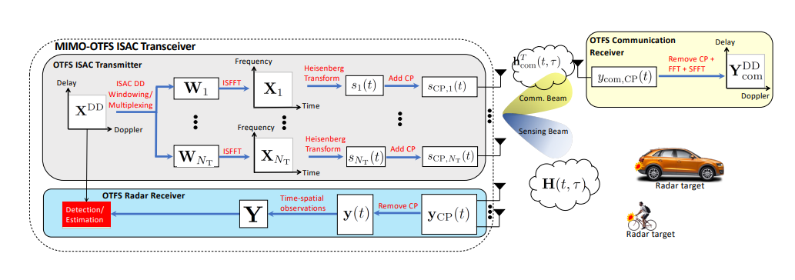
CURRENT RESEARCH
For example Keskin et al creates new New Radar Sensing Algorithm for ISAC systems that can perform better than conventional Radar sensing Algorithms.
  Integrated Sensing and Communications with MIMO-OTFS Musa Furkan Keskin

Slide 4
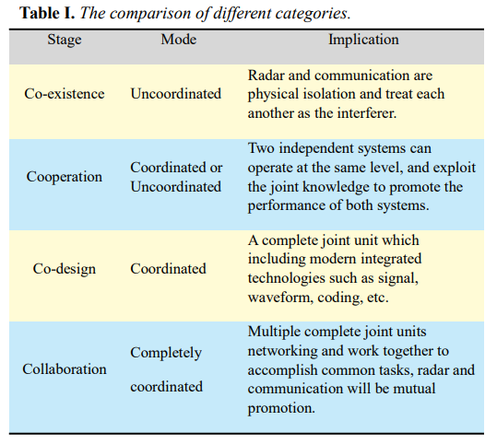
PROBLEMS WITH CURRENT RESEARCH
Aformantioned algorithms are not effectie since they do not exploit the full potencial of the OTFS systems.
Cooperation allows two independent systems to operate jointly—sharing hardware and connecting distributed objects—by using shared knowledge to enhance performance rather than interfering.
Source: «Joint Radar and Communication: A Survey» Zhiyong Feng et al

Slide 5
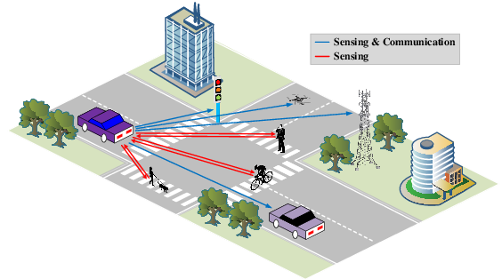
PROBLEMS WITH COOPERATION
Researchers also addressed the performance tradeoffs to evaluate the constraint relation in cooperation systems.
  One example is how to maximize the probability of detection, while satisfying the information rate requirement in the facility consisting of a passive radar and a communication receiver.
In this proposal this effects are not considered.

Slide 6
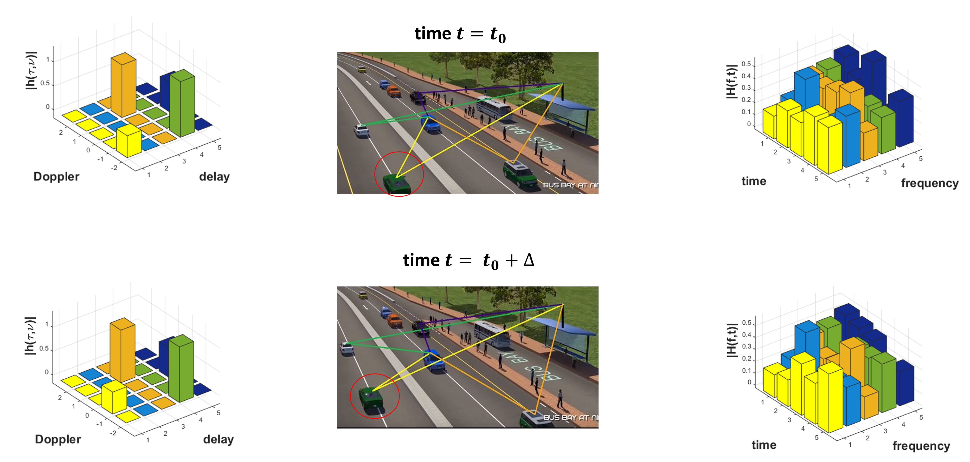
PROBLEM
Assume number of autonomus vehicles that tries to sense the enviroment and communicate with each other.
The vehicles try to use not only their signals to sense the enviroment but also the the signals from other vehicles

Slide 7
POTANSİYEL KAZANIMLAR
OTFS sistemlerde en büyük zorluklardan birisi alınan sinyalin çözülmesidir. Farklı sistemlerin birbiri ile iletişime geçmesi DD responsu estimate etmeyi kolaylaştırabilir.
Birbiri ile yardımlaşan sistemler ile düşük SNR larda DD response daha iyi estimate edilebilir.

Slide 8
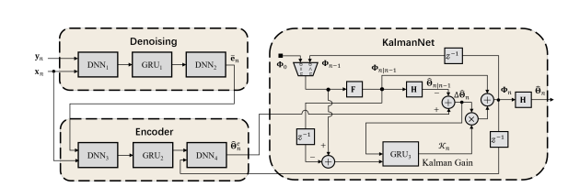
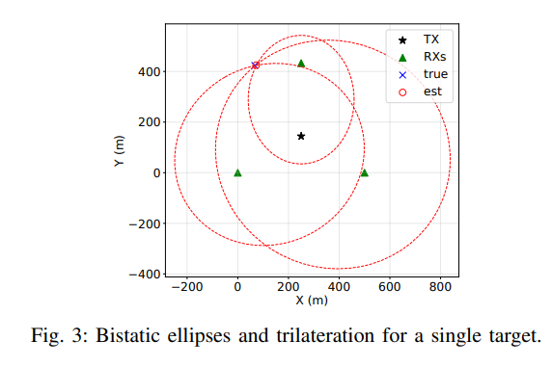
RELATED RESEARCH
Deep Learning-Based Extended Target Tracking in ISAC Systems
  Yiqiu Wang, Meixia Tao, Shu Sun
  They propose ISACTrackNet, a deep learning-based tracking model that directly estimates ET kinematic and contour parameters from noisy received echoes.
  This research uses track algorithms based on only one platform.
MULTI-SCOUT: Multistatic Integrated Sensing and Communications in 5G and Beyond for Moving Target Detection, Positioning, and Tracking
  Yalin E. Sagduyu et al.
  This paper considers a distributed architecture in which one gNB transmits a periodic OFDM-PRS waveform while multiple spatially separated receivers exploit the same signal for target detection, parameter estimation and tracking.

Slide 9
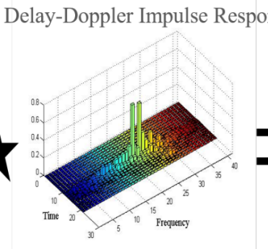
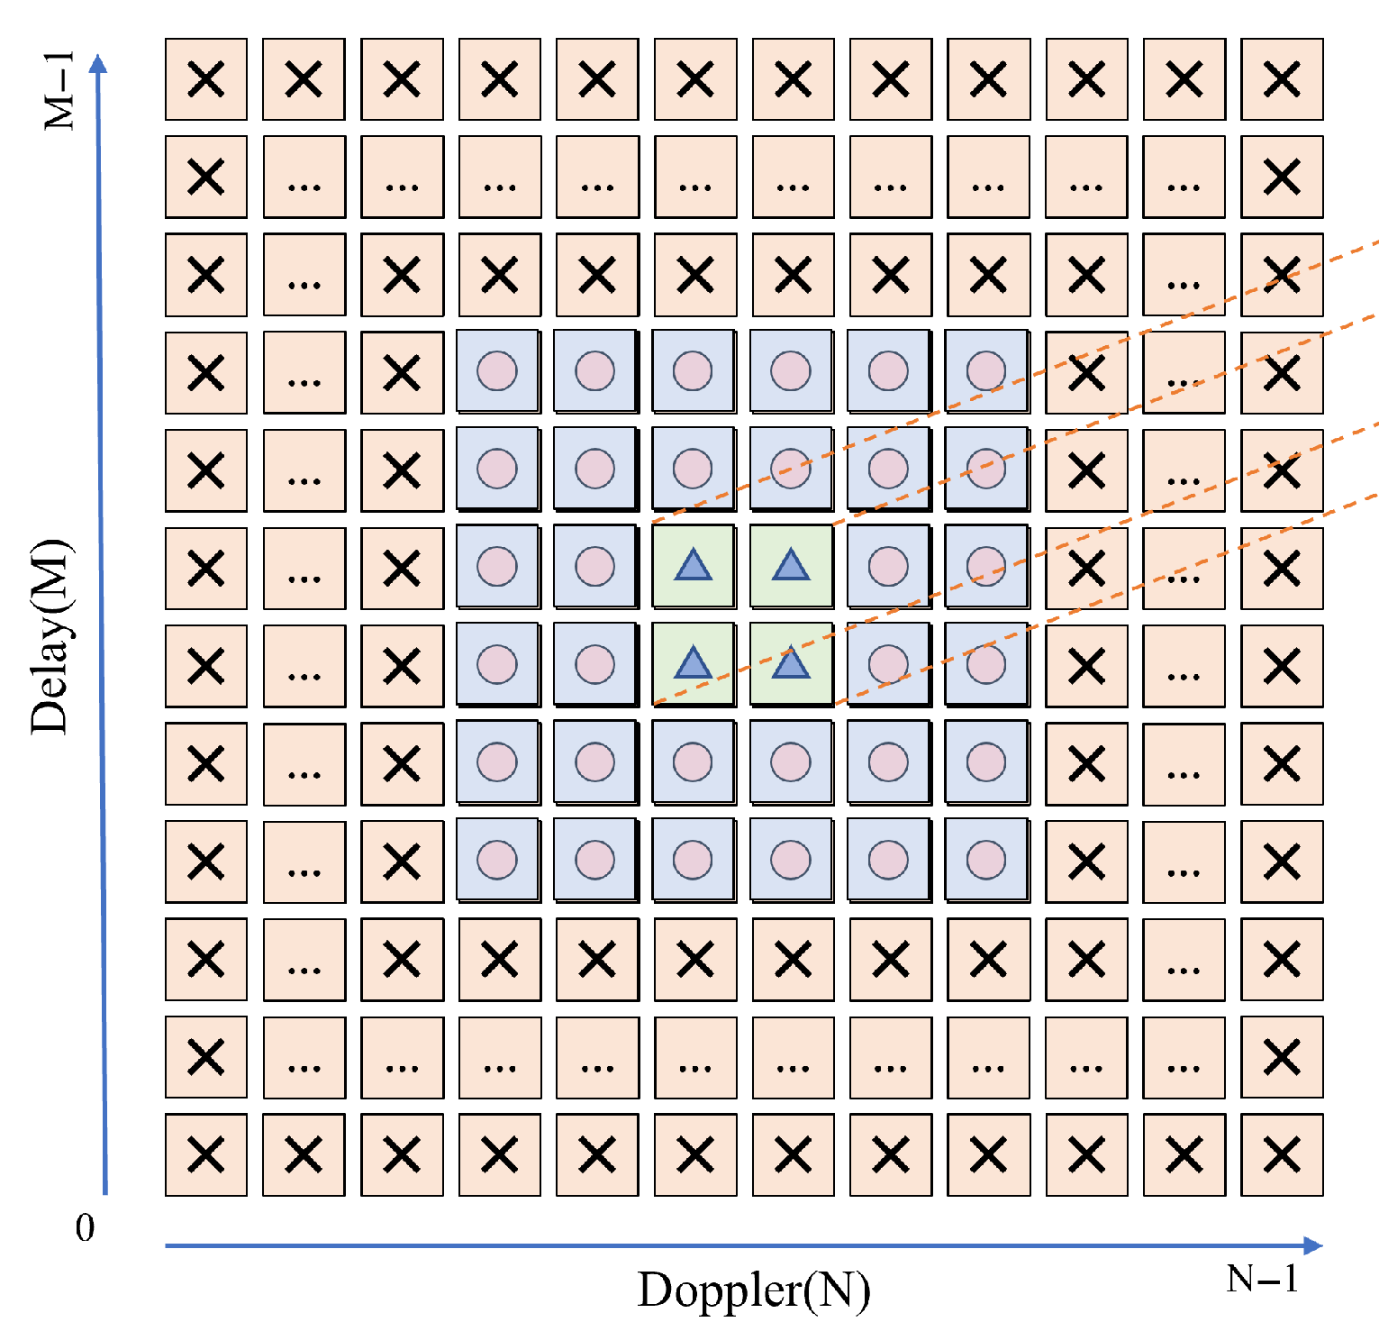
PROBLEM SETTING
S1
S4
Araçlar birbirine embedded pilot wave ile konumlarını ve birbirlerine iletmek istedikleri diğer bilgileri iletecektir.
Embedded pilot wave kısmı radar olarak çalışacaktır.
S0
S2
S3

Slide 10
ÖNERİLEN ÇÖZÜM 1
Bir NN eğitilerek ortamda bulunan objelerin konumu tespit edilmeye çalışılabilir.
NN input olarak konumları ve DD responsu alacaktır.
S1
S4
S0
S2
S3

Slide 11
ÖNERİLEN ÇÖZÜM 2
Burada sensorlerin elde ettikleri trackler her araçta dağınık olarak birleştirilecektir.
Bu çözümde sensörler birbiri ile iletişime geçecek ama birbirlerine tespitlerini gönderecektir.
Rx 1 Tracks
Rx 2 Tracks
Track Fusion
Rx 3 Tracks
Rx 4 Tracks

Slide 12
Q&A

Slide 13
POTANSİYEL DİĞER ARAŞTIRMA KONULARI
OTFS ISAC sistemlerde sensörler daha iyi tespit için koordine edilebilir.

